Slide 1
User Defined Operators

Slide 2
Grammar issues

Slide 3
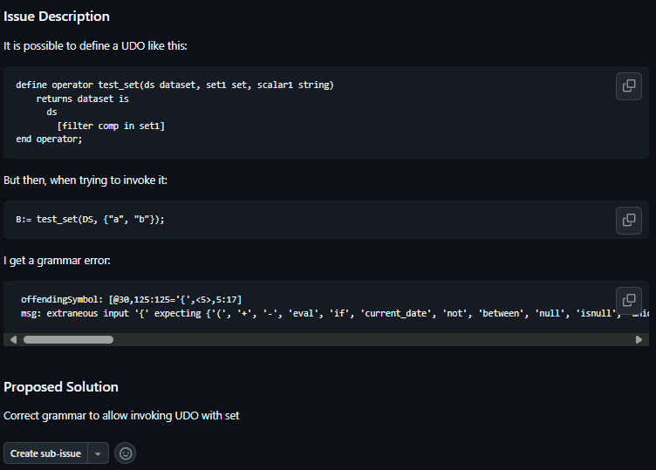
Correct gramar to allow using sets in UDOs
Cannot provide a set as input parameter for UDO · Issue #410 · sdmx-twg/vtl
To do: Correct the grammar

Slide 4
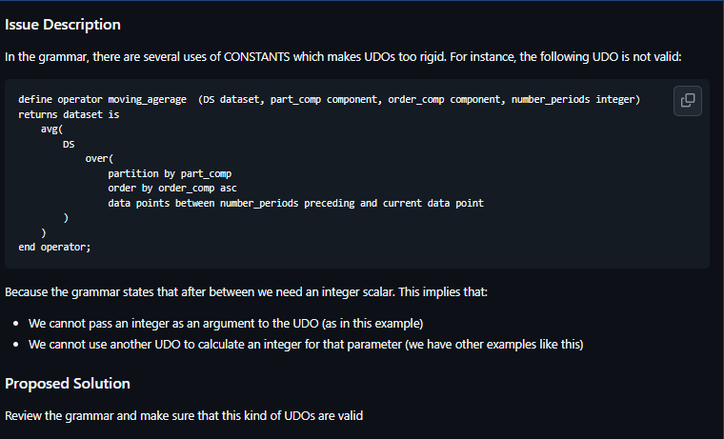
Review grammar to makes UDOs more flexible
Review grammar to make UDOs more flexible · Issue #390 · sdmx-twg/vtl
Proposal:
Analyse all uses of constants in the grammar.
Change them to allow using variables or UDOs.

Slide 5
Clarification/further specification

Slide 6
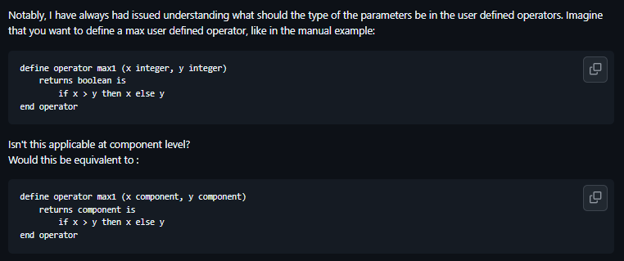
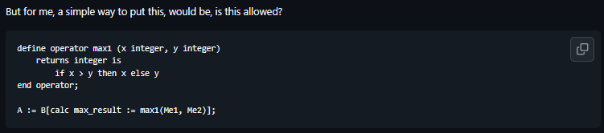

Component expressions vs scalar epxressions
Component expressions vs. scalar expressions · Issue #51 · sdmx-twg/vtl
Proposed principles:
Proposal to have only one option to do things.
What is allowed and what is not should be completely clear.
Be strict, but make the language simple
Consider the difference between Datasets and component/scalars

Slide 7
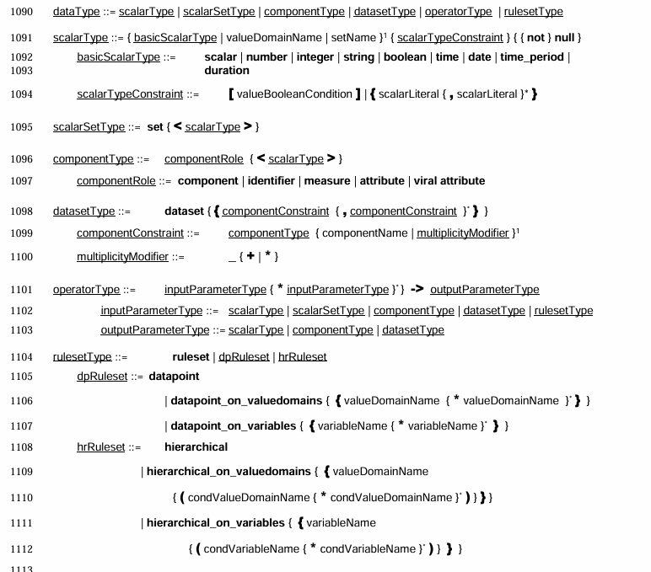
The data type syntax definition

Slide 8
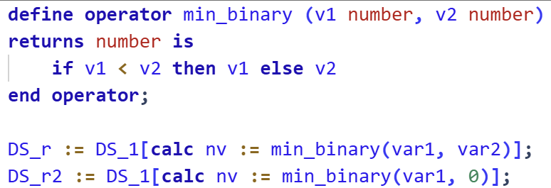

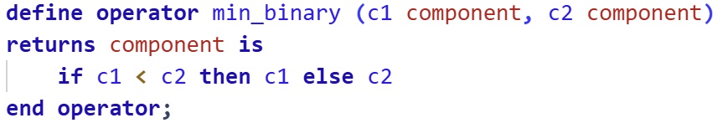
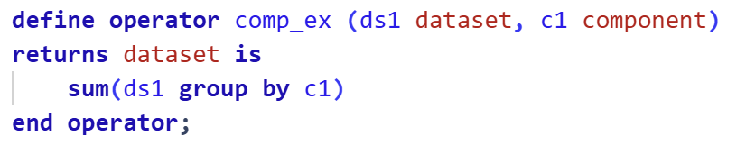
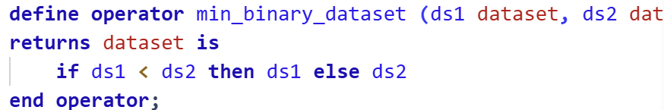
Kick-off proposal
Component should be used only for the cases when we pass as argument a component whose name (reference) would be substituted.
This in practice means that component can never be returned
Any scalar argument in an UDO may take as input a scalar or a component of the data type scalar. A UDO returning a scalar may be used to calculate a component.
If we need a UDO that returns a dataset, even if it essentially does the same, we need a different UDO.

Slide 9
New features

Slide 10
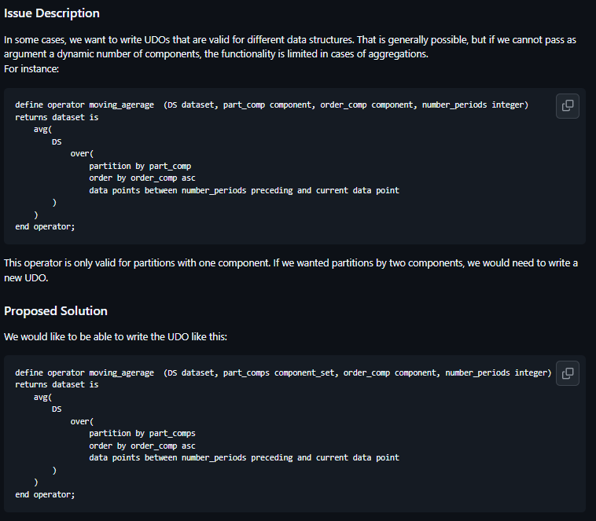
Sets of components as arguments for UDOs
Allow set of components as argument of UDOs · Issue #389 · sdmx-twg/vtl

Slide 11
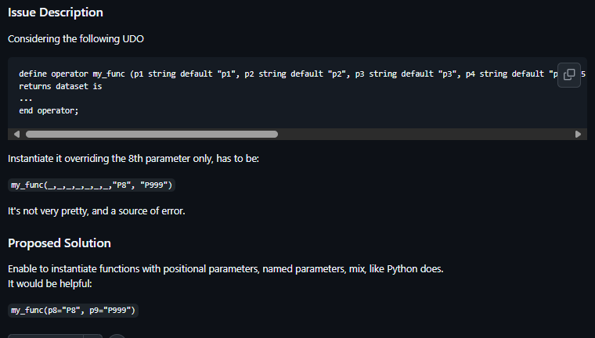
UDO Default parameters
UDO default parameters · Issue #396 · sdmx-twg/vtl

Slide 12
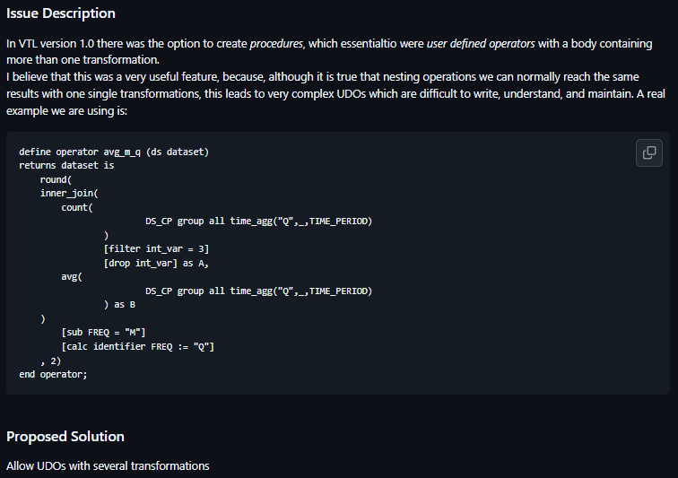
Reinstating procedures
Add back procedures (or allow UDOs with several transformations) · Issue #388 · sdmx-twg/vtl
VTL 1.1 User Manual (see page 53)

